Slide 1
BlockRunner
By WeiHeng and Lloyd

Slide 2
Task Distributions
LLoyd
GDD
Test cases
Powerpoint slides
Unity Game
Recording gameplay video
Screenshots
Wei Heng
GDD,
Test cases
Powerpoint slides
Unity Game

Slide 3
Game Introduction
BlockRunner is a first person maze game.
Player have to navigate through the maze and jump on blocks/platforms to get through the next level.
Player who finish the game with the fastest time wins.

Slide 4
Learning points
We both learn to work together as efficiently as possible ( Lloyd has to revise for his test)
We focus on working on the project early.
Motivate each other to work on the project, as we are lazy at the same time.

Slide 5
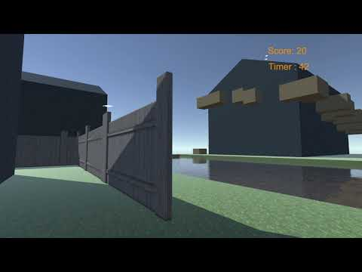
Video Gameplay
https://www.youtube.com/watch?v=NRvRHxBIFDI

Slide 6
Github
https://github.com/12-Lloyd/Llama_Lloyd_Project

Slide 7
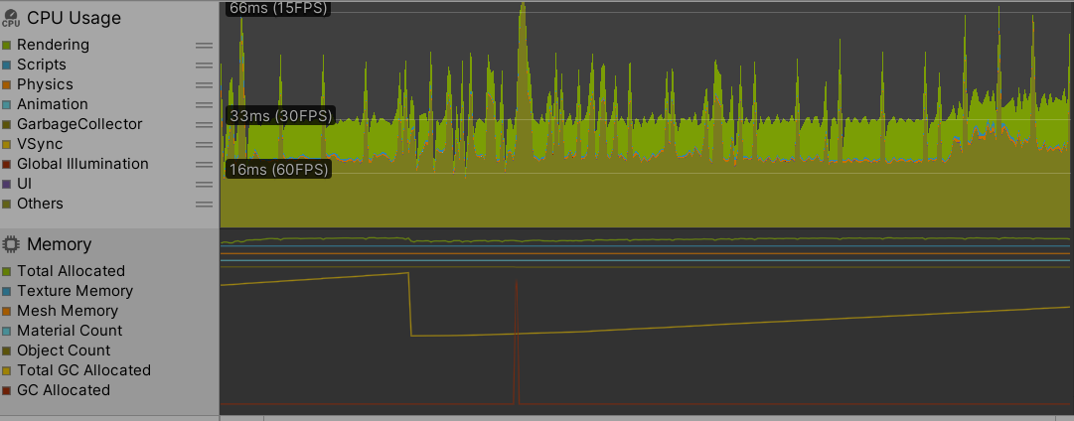
Screenshot
Unity profiler

Slide 8
The End

